Slide 1
Teng Wen Hui
L1 WDD Project

Slide 2
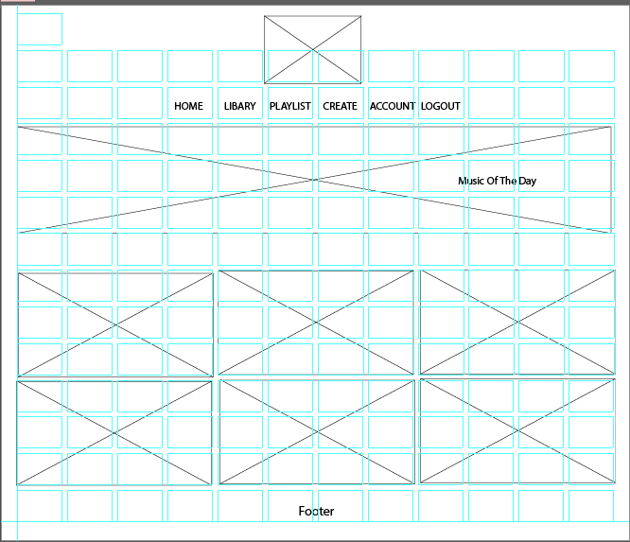
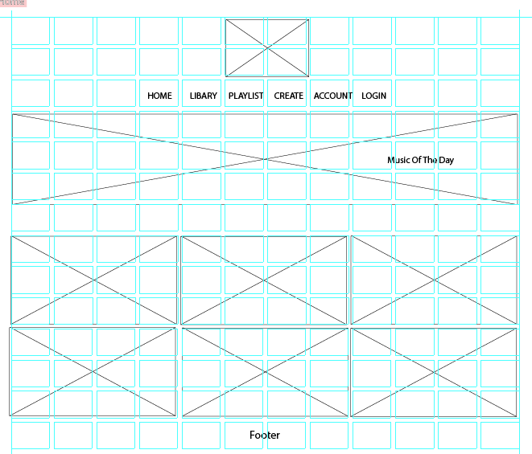
WireFrames
Home (when login )
Home (when not login )

Slide 3
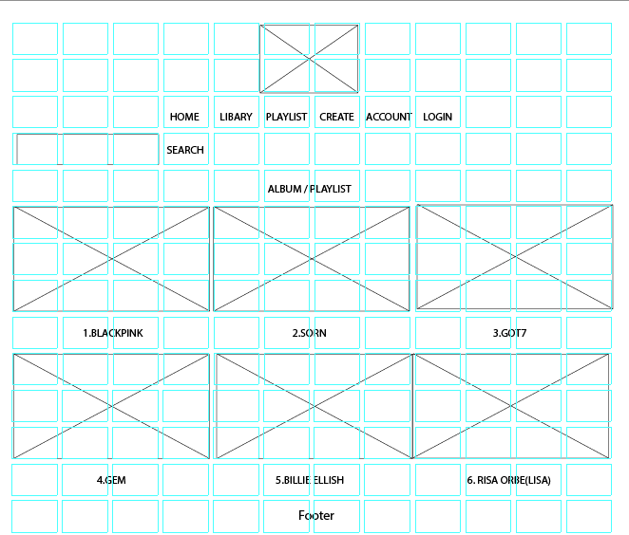
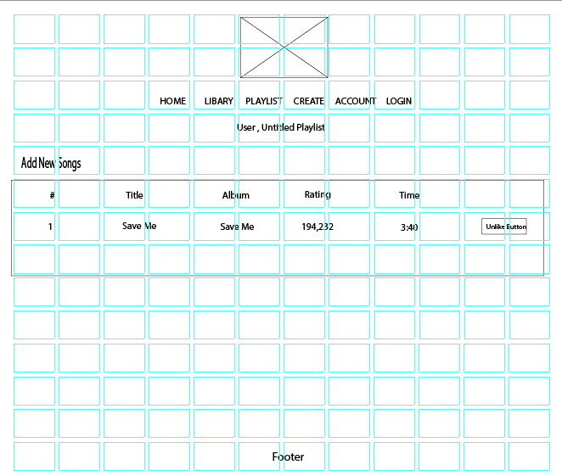
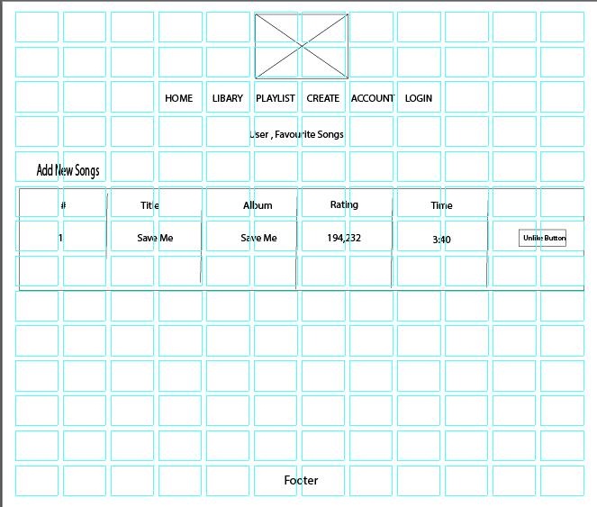
WireFrames
Library
Create (Untitled Playlist )

Slide 4
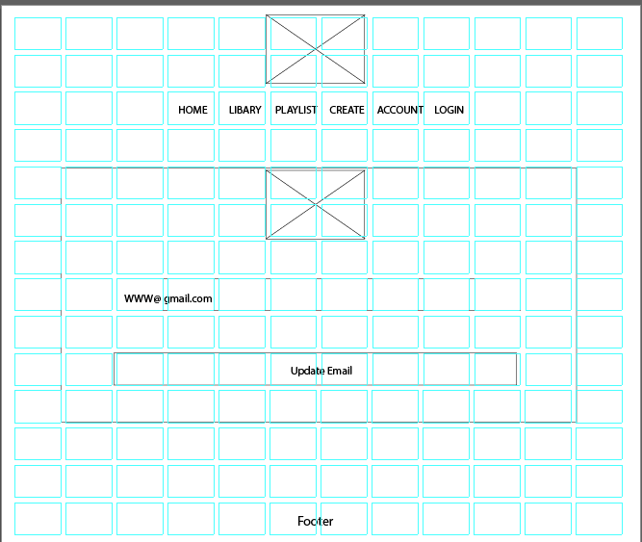
WireFrames
Edit Account
Playlist(Favourite )

Slide 5
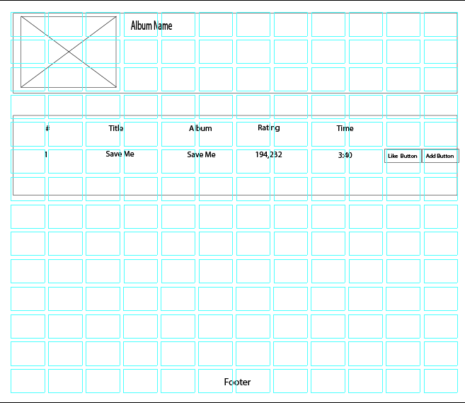
WireFrames
Song Album

Slide 6
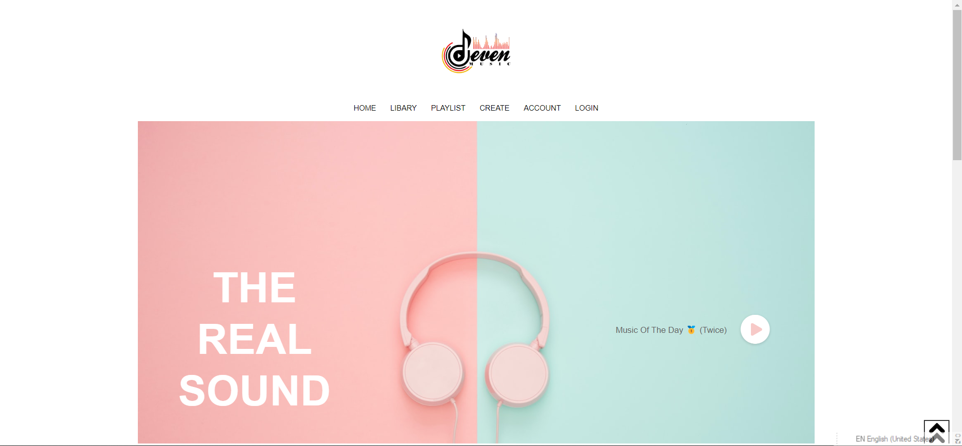
User Will Land At The Home Page First

Slide 7
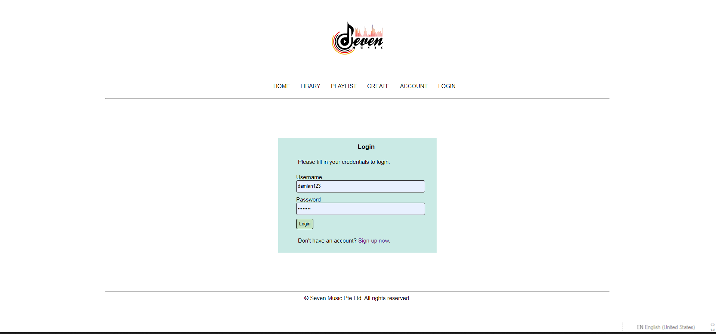
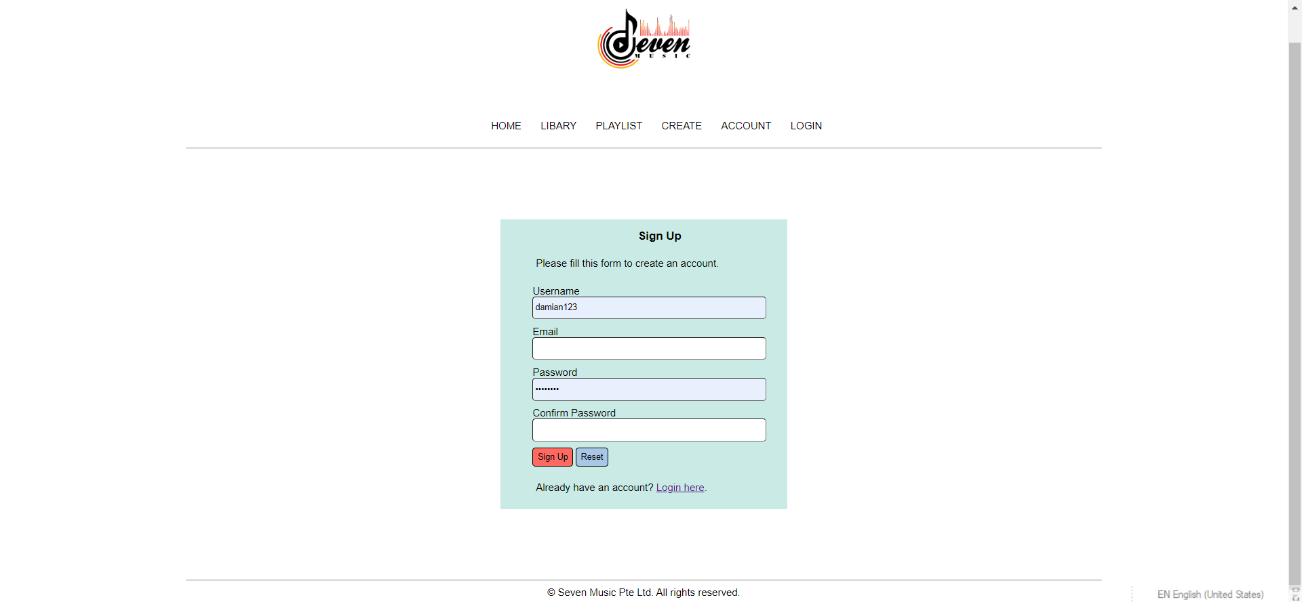
User Will Need To Login / Register For A Account

Slide 8
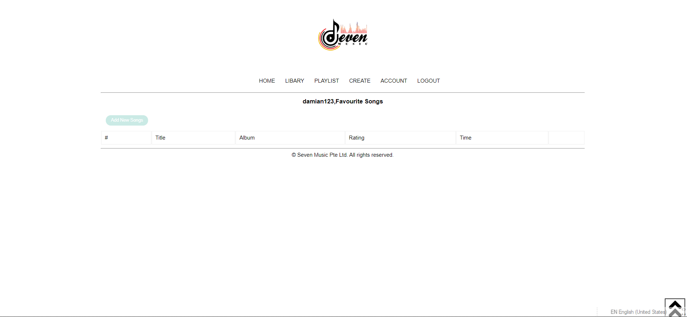
Upon Signing in user will land at the favourites page

Slide 9
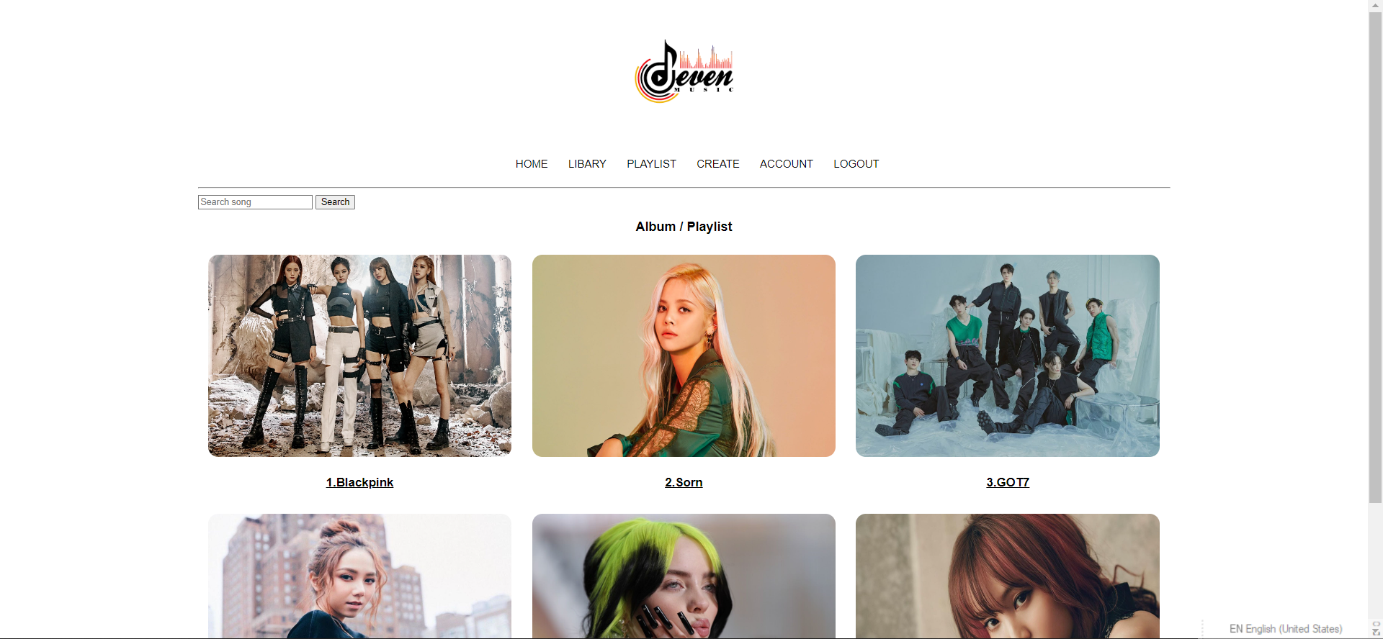
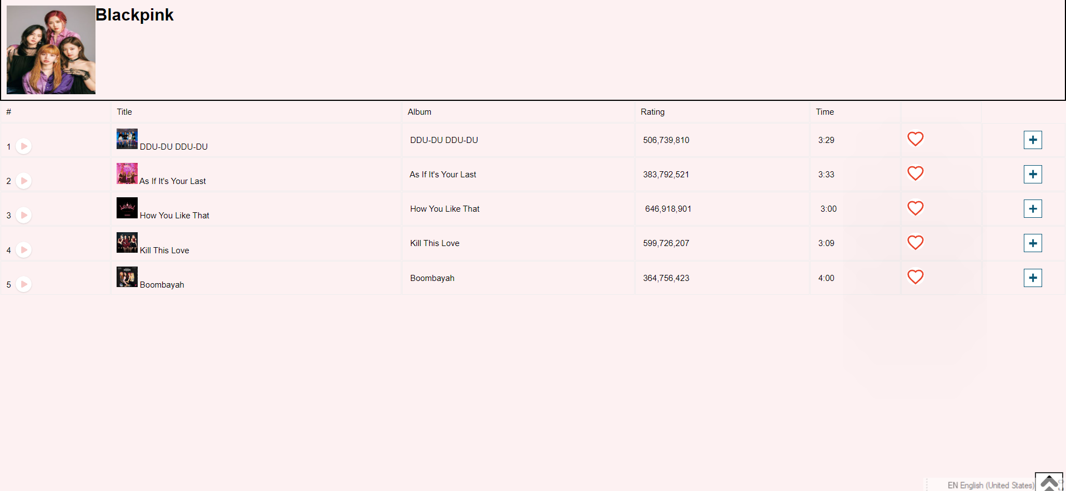
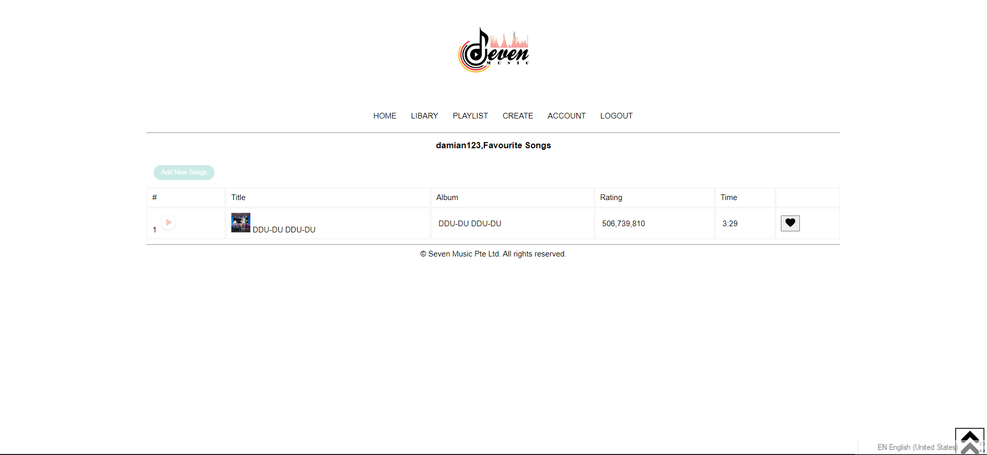
User Will Then Click Create Playlist Button To Add A Song To His / Favourites with the love button

Slide 10
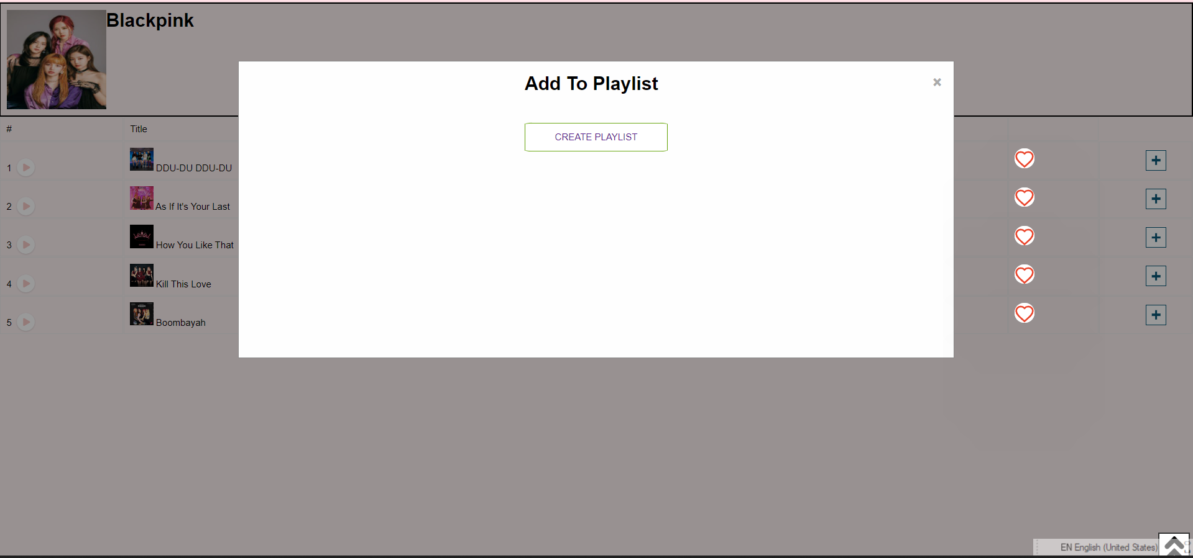

User Can Also Click Create Playlist Button To Add A Song To His / Favourites with the plus button

Slide 11
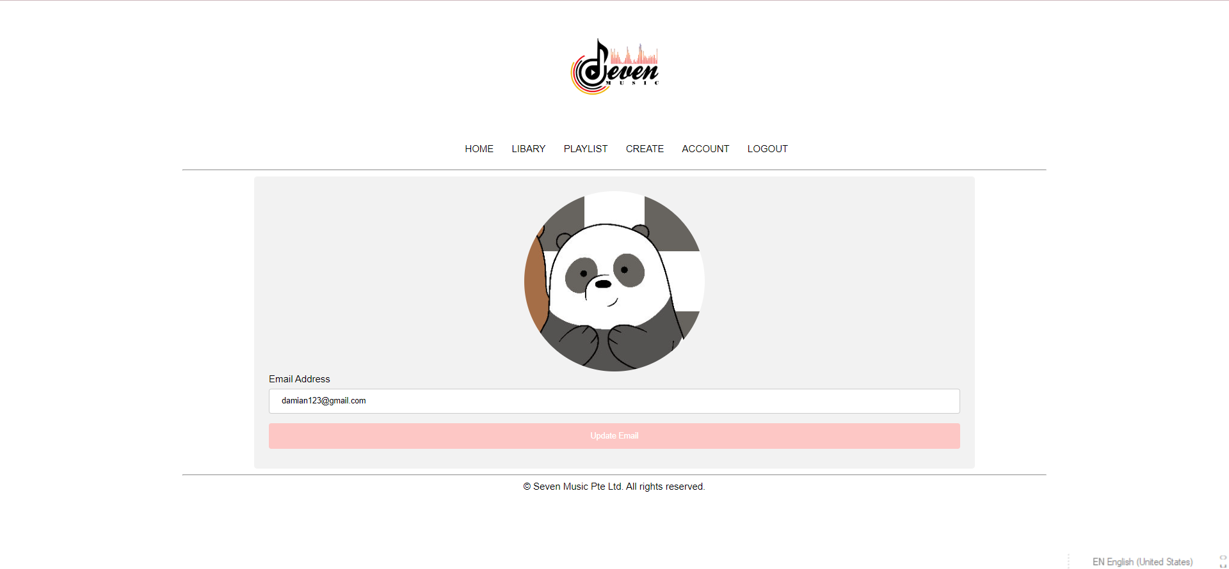
User Can Edit Account In Account Page too.

